Slide 1
Artificial Intelligence
Dr. O. I. Adelaiye

Slide 2
Rules
Attendance is compulsory (80%)
Short gun full implementation
Silence very important
30% or 70% Coursework and Assessments
70% or 30% Examination

Slide 3
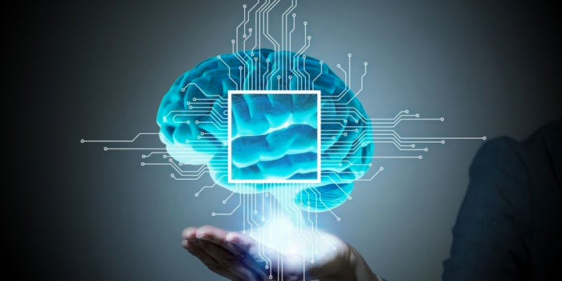
What is Intelligence?

Slide 4
What is Intelligence?
the ability to learn or understand or to deal with new or trying situations
the skilled use of reason
the ability to apply knowledge to manipulate one's environment or to think abstractly as measured by objective criteria (such as tests)

Slide 5
So What is Artificial Intelligence?
Systems that think like humans?
Systems that act like humans?
Systems that think rationally?
Systems that act rationally?

Slide 6
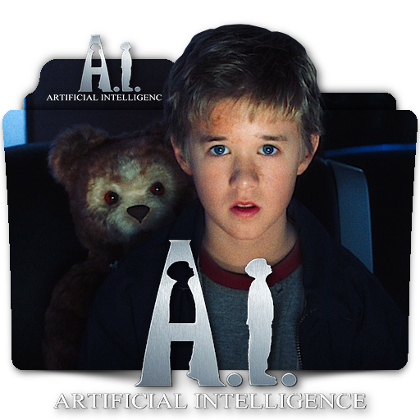

Slide 7
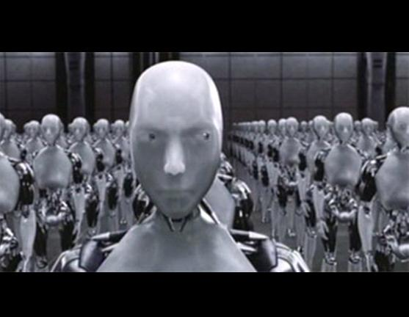

Slide 8
Artificial Intelligence
"The exciting new effort to make computers think…machines with minds, in the full and literal sense" (Haugeland, 1985)
"[The automation of] activities that we associate with human thinking, activities such as decision-making, problem solveing, learning…” (Bellman, 1978)

Slide 9
Turing Test
Designed in 1950 by a Mathematician Alan Turing.
A Turing test is a test performed to determine a machine’s ability to exhibit intelligent behavior.
The basic concept behind the test is that if a human judge is engaged in a natural language conversation with a computer where he cannot reliably distinguish machine from human, the machine passes the test.
Responses from both participants in the conversation are received in the form of a text-only channel.

Slide 10
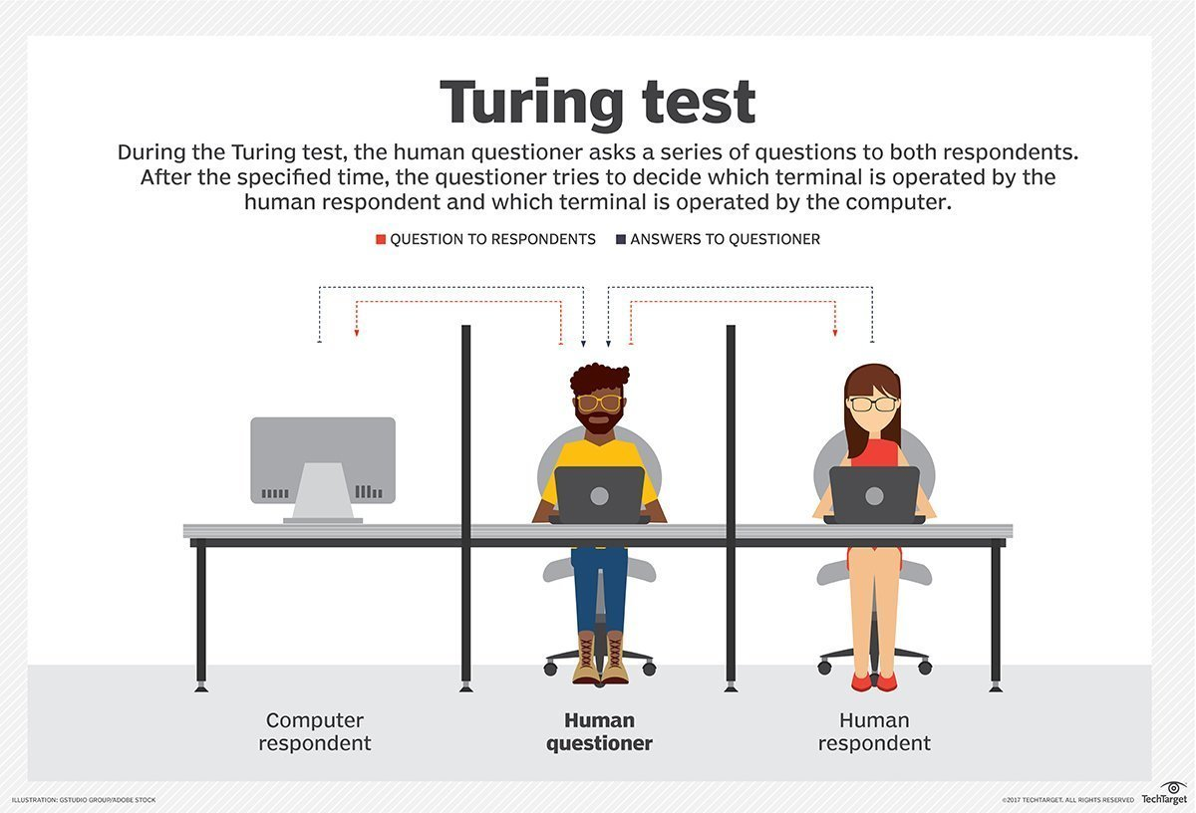

Slide 11
Turing Test
The Turing test is used to measure a machine's ability to think and is an important concept in the philosophy of artificial intelligence.
A machine’s success at thinking can be quantified by the likelihood that a human will misidentify it as a human subject.

Slide 12
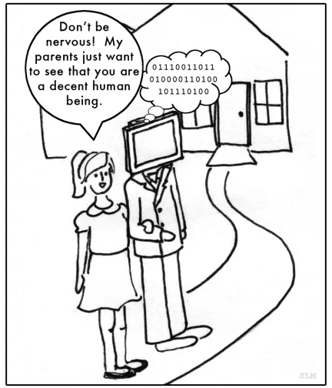

Slide 13
Turing Test (Imitation Game)
A computer's ability to think is determined through an imitation game.
In this game, there are three players A, B and C. Player A is a man, B a woman and C is of either sex. C cannot see A and B, and communicates with the others through written notes.
Player C determines which of the others is a man and which is a woman by asking a series of questions. Player A tricks the interrogator into making the wrong decision, while B attempts to guide C toward the right path.

Slide 14
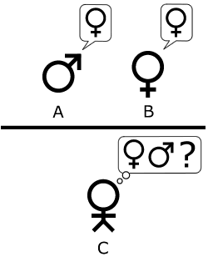
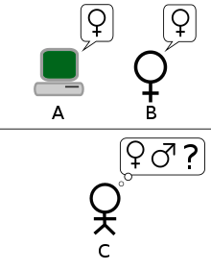
Imitation Game

Slide 15
Imitation Game
In the original imitation game test, Turing proposes A to be a computer. The computer pretends to be a woman and tricks the interrogator into making an incorrect evaluation. The machine's success is determined by comparing the outcome of the game when A is a computer against when A is a man. If the interrogator goes wrong when playing the game between man and woman, the computer is assessed to be intelligent.
There are some variations on the interpretation of how a Turing test should be performed but the basic premise is whether a human judge can determine whether he is talking to a machine or another human.

